Slide 1
Chapter 15
Wireless LANs

Slide 2
Introduction
Differences between wired and wireless LANs
Medium
Modern Ethernet LANs use full-duplex (send and receive at the same time) point-to-point communication media
Wireless LANs use air, usually multiple access broadcast communication (half-duplex)
Due to low power, devices can only send or receive at a time: half-duplex
Hosts
Hosts attached to an Ethernet LAN are effectively fixed
Moving a host to another network requires a new network address
Hosts attached to a Wireless LAN usually expect mobility without changing address
Consider making a call over a data service (Skype, WhatsApp call, etc.) whilst on a train
Couldn’t do this with Ethernet!

Slide 3
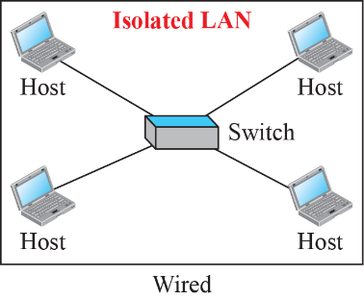
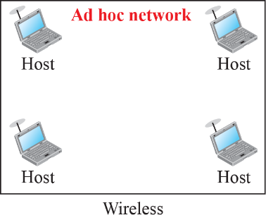
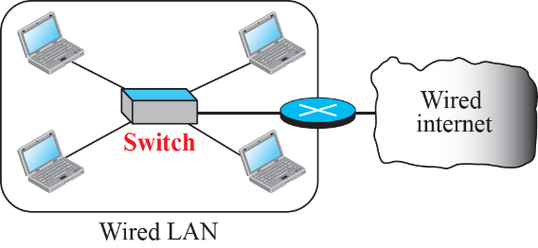
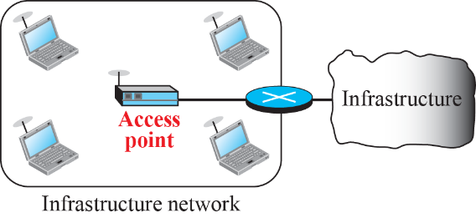
Introduction
Differences between wired and wireless LANs
Isolated LANs
Isolated Ethernet LANs require central link-layer switch
Isolated wireless LANs do not require a central switch
Connection to Other Networks
Ethernet/wireless LANs can connect to other networks through a router
Wireless LAN stations must first connect to an access point that is in turn connected to the router

Slide 4
Introduction
Characteristics
Attenuation – signals decrease rapidly because the signal disperses in all directions
Interference – often receive signals from other senders using the same frequency band
The frequencies used by WLANs are often used by other wireless devices, e.g., telephone handsets
Multipath propagation – signal can be reflected back from obstacles such as walls, causing signals to be received at different phases (signal “echos”)
Error control – above factors mean error control more serious than for wired network

Slide 5
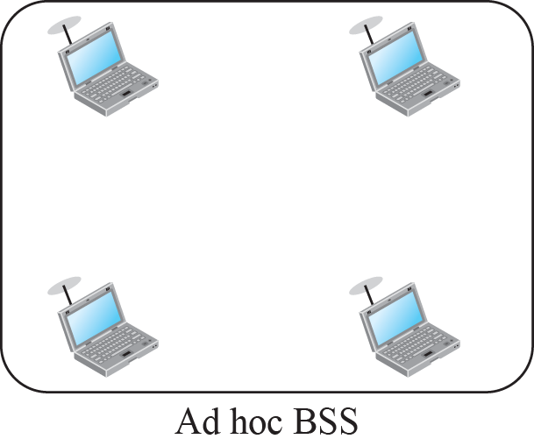
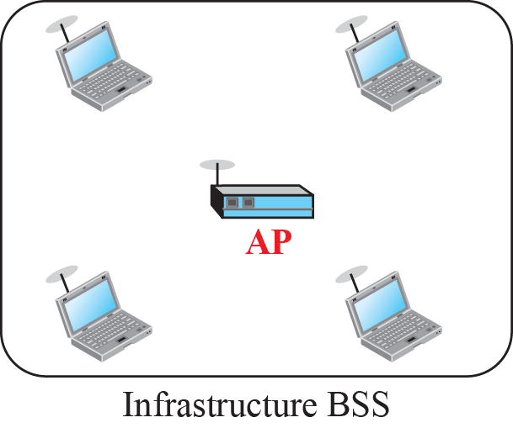
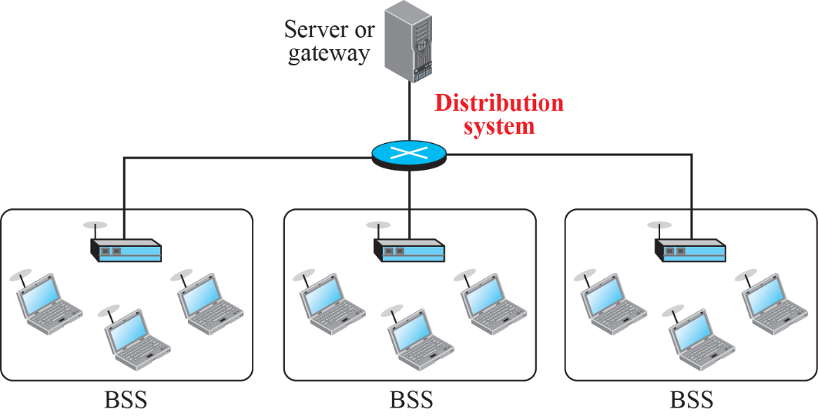
IEEE 802.11 Project
IEEE 802.11 defines the physical and data-link layers for wireless LANs (WLANs)
Sometimes called Wireless Ethernet or WiFi
Defines two kinds of services:
Basic Service Set (BSS) – either ad hoc or using a central base station (access point, AP)
When BSS has an AP, known as infrastructure BSS
Ad hoc can form a network without an AP but cannot send data to other BSSs, stations agree to be part of a BSS and can locate one another
Extended Service Set (ESS) – two or more BSS connected through a distribution system
ESS: distribution system connects the APs in BSSs, communication outside own BSS must be through AP,
ESS: inside BSS, stations can communicate without AP within range

Slide 6
IEEE 802.11 Project
IEEE 802.11 defines the physical and data link layers for wireless LANs (WLANs)
Defines three kinds of stations connected to the WLAN:
No-transition
Station is either stationary or mobile within the same BSS
BSS-transition
Station can move between BSSs within the same ESS
ESS-transition
Station can move between ESSs
Communication may not be continuous when moving between ESSs

Slide 7
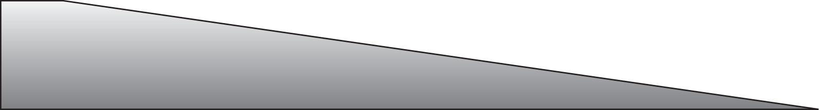
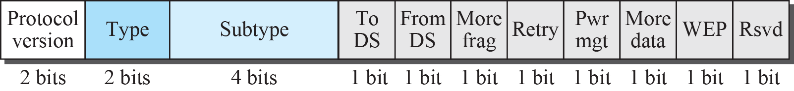
Figure 15.9: Frame format

Slide 8
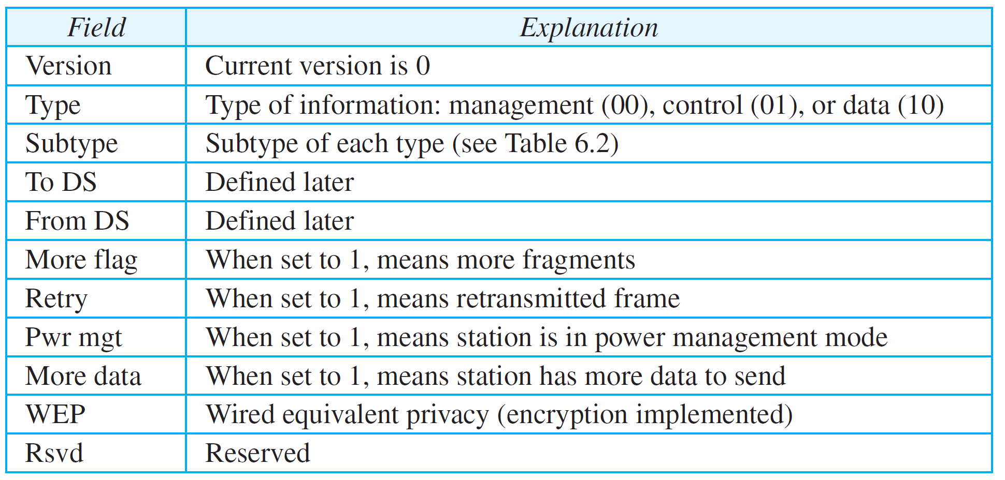
Table 15.1: Subfields in FC field
Frame control (FC). The FC field is 2 bytes long and defines the type of frame
and some control information.
15.8

Slide 9
Figure 15.9: Frame format
D. This field defines the duration of the transmission that is used to set the value of NAV. Network allocation vector (NAV) that shows how much time must pass before stations are allowed to check the channel for idleness.
Addresses. There are four address fields, each 6 bytes long. The meaning of each
address field depends on the value of the To DS and From DS subfields and will be
discussed later.
Sequence control. This field, often called the SC field, defines a 16-bit value. The
first four bits define the fragment number; the last 12 bits define the sequence
number, which is the same in all fragments.
Frame body. This field, which can be between 0 and 2312 bytes, contains information based on the type and the subtype defined in the FC field.
FCS. The FCS field is 4 bytes long and contains a CRC-32 error-detection sequence.

Slide 10
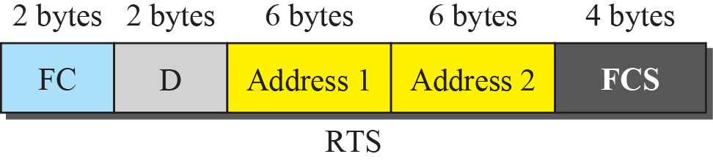
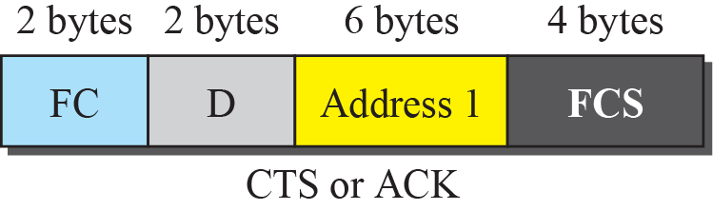
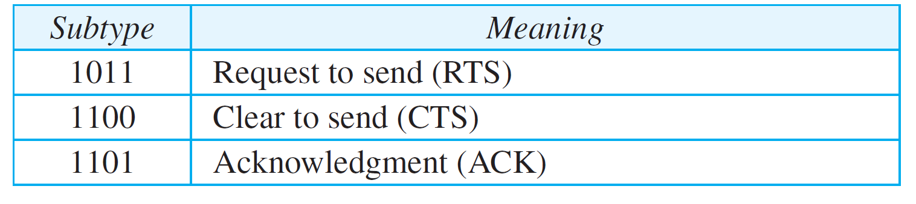
Figure 15.10: Control frames

Slide 11
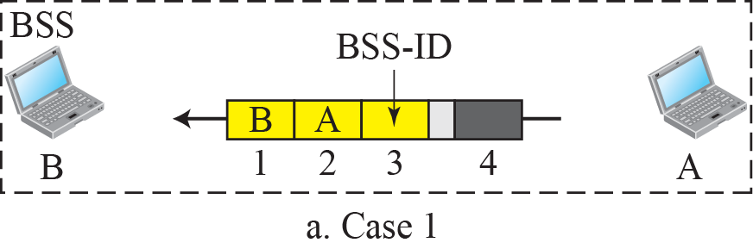
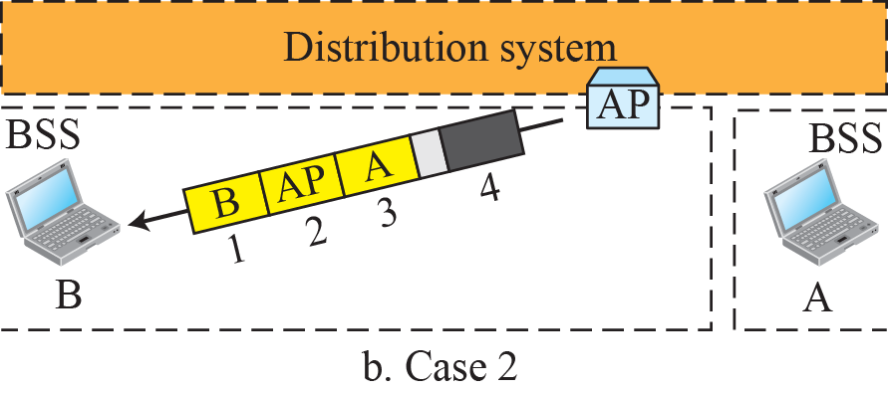
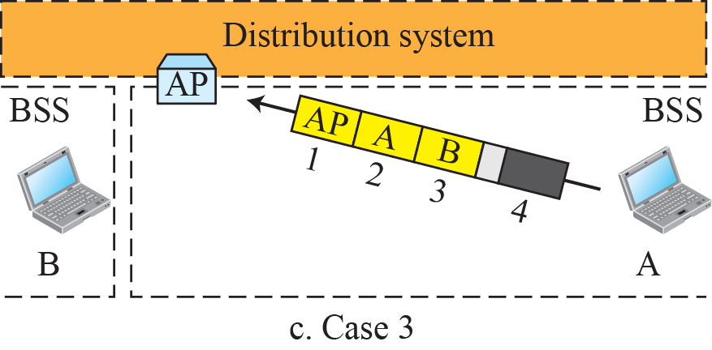
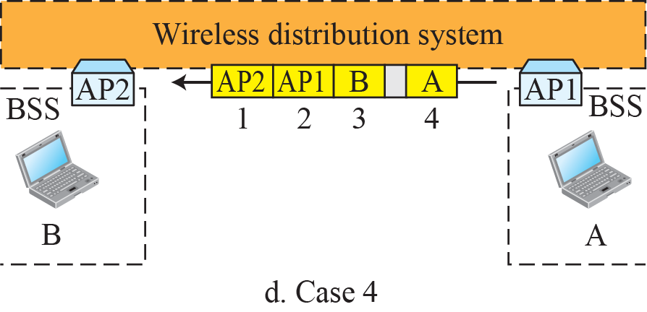
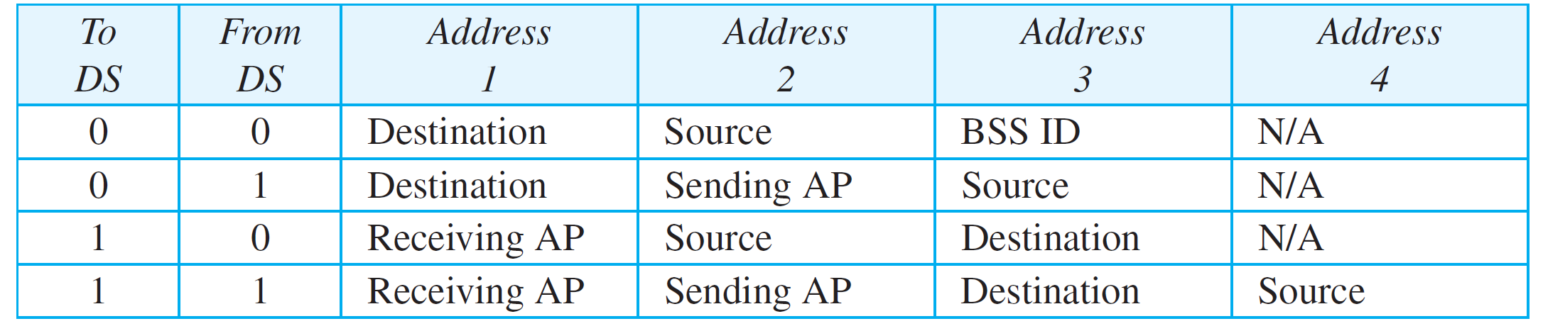
Figure 15.11: Addressing mechanisms
The IEEE 802.11 frame (wireless LAN) addressing mechanism specifies four cases,
defined by the value of the two flags in the FC field, To DS and From DS.
Each flag can be either 0 or 1, resulting in four different situations.
The interpretation of the four addresses (address 1 to address 4) in the MAC frame depends on the value of these flags, as shown in Table 15.3.
Table 15.3:

Slide 12
Figure 15.11: Addressing mechanisms
Rules for addresses:
Address-1, always next device that frame will visit,
Address-2 previous device that frame has left,
Address-3 = Final destination if it is not defined by 1 or original source if not defined by 2, Within Ad hoc, Address-3 = BSS-ID
Address-4-original source when distribution is also wireless, when wired distribution, Address-4= Not applicable (N/A), also same for Ad-hoc
For case-d, address-3 can be destination or original source. Address-4 will be original source (wireless distribution), so address-3 should be final destination
Where distribution is wired, APs are wired, frames between APs are using standard MAC frame 802.3 through distribution system, requires only two addresses (SA and DA)
Table 15.3:

Slide 13
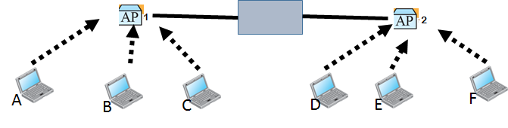
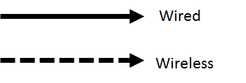
Addressing mechanisms
LAN
Station B is communicating with station F through AP-1 and AP-2 where AP-1 and AP-2 are connected by wired distribution system (LAN)
Addressing:
Station-B to AP1: Address-1:AP1; address-2: B; Address-3: F, Address-4: not used
Now AP1 will extract information from 802.11 frame and convert it to a 802.3 Frame (Ethernet) and AP1 works as a wireless bridge. Then handover the frame to AP2.
Addressing AP1 to AP2 (Ethernet only two address): Destination address: F and Source address: B
Then AP2 extract information and transforms 802.3 frame to 802.11 frame.
Addressing AP2 to F: Address-1:F; address-2: AP2; Address-3:B, Address-4: not used

Slide 14
Bluetooth
Bluetooth is a form of ad hoc WLAN for interconnecting devices in a very limited area – a Personal Area Network (PAN)
Useful for connecting telephones, notebooks, computers, cameras, printers, etc.
Early Bluetooth standardized under IEEE 802.15
Bluetooth networks are called piconets
Can have up to eight stations – one primary and up to seven secondaries (active)
All secondaries are synchronised with primary
Additional secondaries can exist in the parked state
Synchronised with primary but cannot participate in communication until it is moved from parked to active state, only 8 stations can be active at a time
Secondary stations can also be a primary in a second piconet, collectively called a scatternet
Note: each station can only be a member of two piconets at any one time
Communication can be one-to-one or one-to-many between primary and secondaries
Notes:
Piconet 微微网，多个微微网之间还可以互联形成散射网(Scatternet)

Slide 15
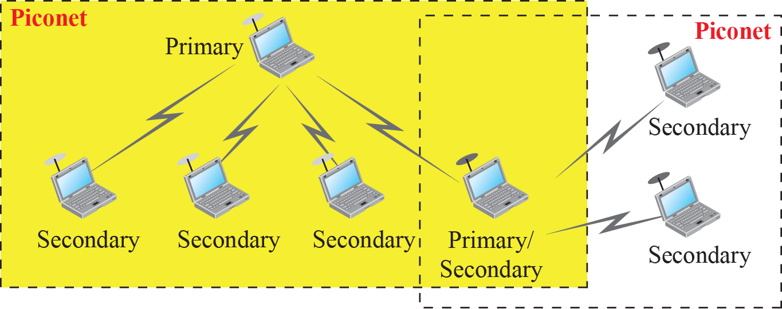
Bluetooth

Slide 16
Chapter 16
Other Wireless Networks

Slide 17
Cellular Telephony
Cellular telephony is designed to provide communications between
Two moving units or
One moving unit and one stationary unit
Moving units are known as mobile stations (MSs)
Stationary units are known as land units
Requires:
Service provider must be able
to locate and track a caller
To assign a channel to the call
To transfer the channel from one base station to another as caller moves

Slide 18
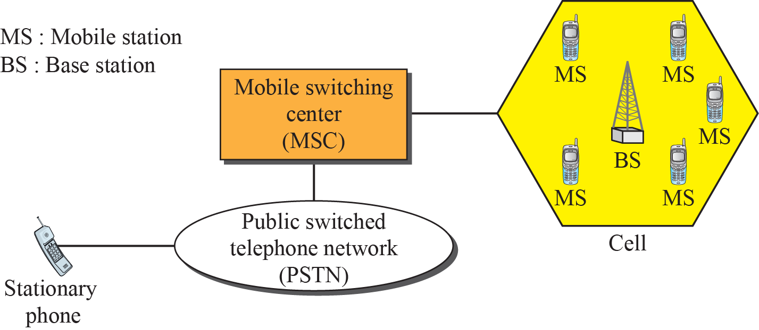
Cellular Telephony
Each cellular service area is divided into small regions – cells
Each cell contains an antenna
Controlled by a solar- or AC-powered network station – a base station
Base stations controlled by switching office – mobile switching center (MSC)
MSC coordinates communication between base stations and telephone central office
Cell size:
Typically 1-12 miles radius
Can be increased or decreased depending on population within the cell

Slide 19
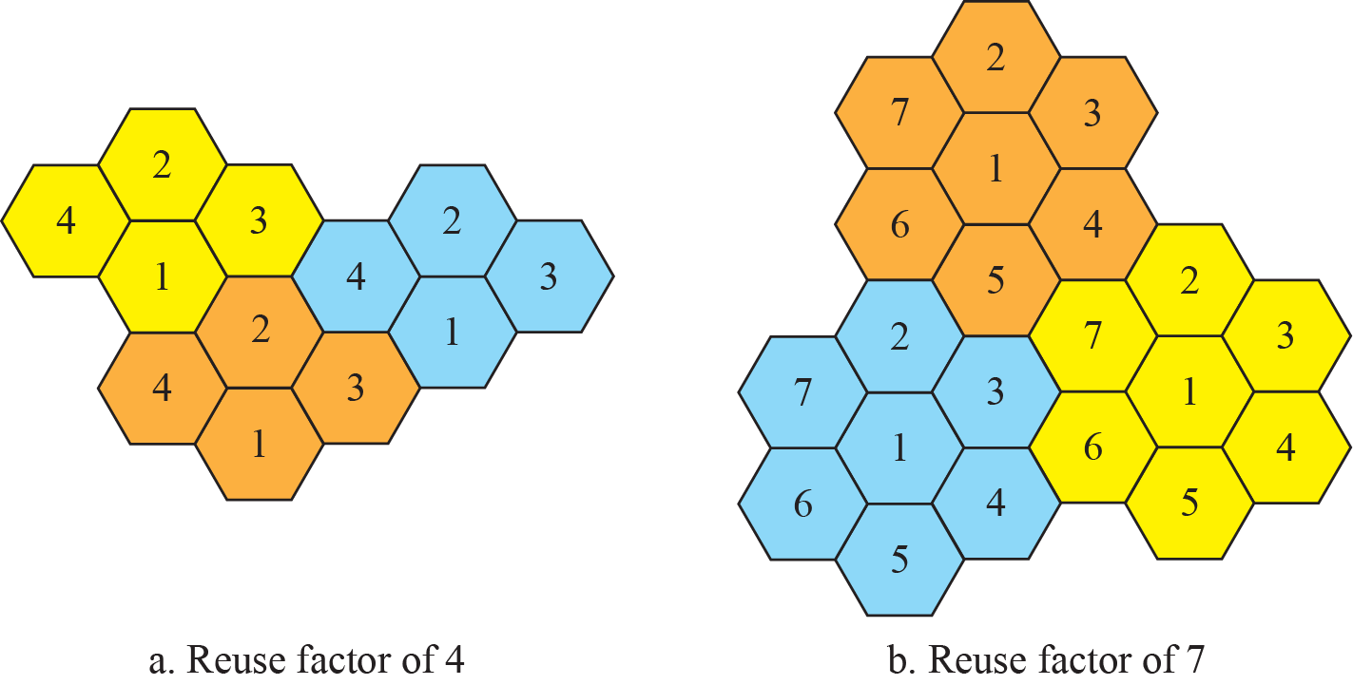
Cellular Telephony
Transmissions within each cell:
Power kept low to prevent interference with neighbouring cells
Neighbouring cells generally do not share same set of frequencies to avoid interference for the users near the cell boundaries
However there is only a limited number of set of frequencies – therefore must be reuse
A frequency reuse pattern is a configuration of N cells, N is reuse factor, each cell uses a unique set of frequencies
This is done in a repeating pattern…
The number in the cells define same pattern
The cells with same number can use the same set of frequencies
In N=4, one cell separates the same set of frequencies, in N=7, two cells separate

Slide 20
Cellular Telephony
To place a call from a mobile station
Mobile station identifies a channel with a strong signal and contacts the MSC (mobile switching center ) providing the telephone number
MSC communicates with central office (CO) and assigns unused voice channel to call and establishes connection (if called party available)
To receive a call
CO communicates with MSC providing telephone number
MSC searches for location of mobile station by querying each cell – paging
Once found, MSC sends ringing signal to mobile station
When answered, MSC assigns voice channel and establishes connection

Slide 21
Cellular Telephony
MSC monitors the level of signal for each call
If the signal strength diminishes, MSC seeks a new cell with better reception
If found, changes call channel (hands off signal from old channel to new)
Hard Handoff – used in older systems
Communication broken off with current base station before establishing with new
Soft Handoff – used in newer systems
Mobile station can communicate with two base stations simultaneously
Communication transferred to new base station before breaking off from old
Roaming
Allows competing networks to provide additional coverage
Revenue usually shared between providers

